Slide 1
GROUP 11
NAME | STUDENT NUMBER | REGISTATION NUMBER
MUGISA BEST | 216018395 | 16/U/7279/PS
KISIGA TIMOTHY | 216003537 | 16/U/6173/PS
KEKIRUNGA JEAN | 216004629 | 16/U/5850/PS

Slide 2
DATA VISUALIZATION
Visualization in R is the process of converting raw data into pictorial information .
Is simply graphical representation of data.

Slide 3
Why do we visualize data ?
Enables users to see different perspectives of data.
Makes it easy to understand complex data.
In a business, it helps in identifying new patterns.
Enables one to know the dynamics of the market in the business world.
Enables one to monitor data.
Translates data patterns into insights making it a highly effective decision making tool.
It summarizes data into simple graphs.
Graphs are attractive unlike raw data.

Slide 4
Data visualization in R
R has functions that enable us create graphs .The graphs /techniques for data visualization include ;
Histogram
Scatter plot
Bar/line graph
Box plot
High-level graphics functions : these start a new graph e.g.
plot, hist, boxplot, qqnorm, curve
Low-level graphics functions : these cannot create a new graph but just add something to an existing graph e.g.
points, lines, abline, segments, polygon
Note: the data being visualized can be exported from a text file or csv file, can be from the predefined data sets or can directly be created from the console

Slide 5
Histogram
A histogram shows frequency distribution between two variables and its used for continuous variables.
hist(y, main=“ ”, xlab=“ ”, ylab=“ ”, col=“ ”)
y : represents the continuous variable.
main: specifies the histogram title
xlab: (x label) it specifies the name of the x axis
ylab:(y label) it specifies the name of the y axis
col: gives the histogram a uniform color.
col=c(“red” , ”green”, ”blue”): this gives the different bars in the graph different color.

Slide 6
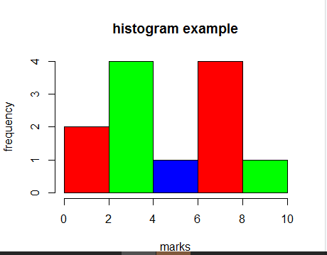
Histogram example

Slide 7
Scatter plot
A scatter plot is used to show relationship between two numeric variables.
plot(x ,y, main=“ ”, xlab=“ ”, ylab=“ ”, col=“ ”)
x and y : represents the numeric variables.
main: specifies the scatter plot title
xlab: (x label) it specifies the name of the x axis
ylab:(y label) it specifies the name of the y axis
col: specifies the color of the scatter points.

Slide 8
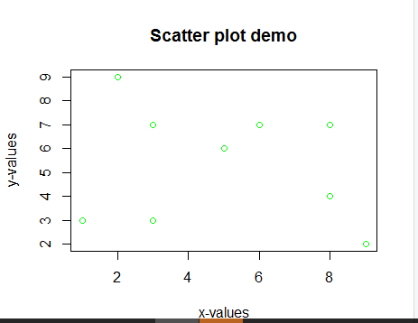

Scatter plot example

Slide 9
Box plot
A box plot shows distribution of data.
It shows the minimum and maximum values of data, the median, the 1st quartile and the 3rd quartile .
boxplot(x, main=“ ” , xlab=“ ”, ylab=“ ”)

Slide 10
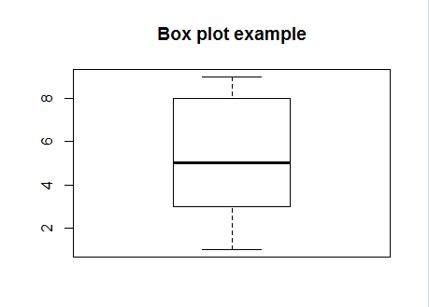

Box plot example

Slide 11
Bar plot
A bar plot is used for comparative data.
barplot(x, main=“ ”, xlab=“ ”, ylab=“ ”, names.args=(“”), col=“ ”)
names.args=(“”): specifies the names of each bar in the bar chat.

Slide 12
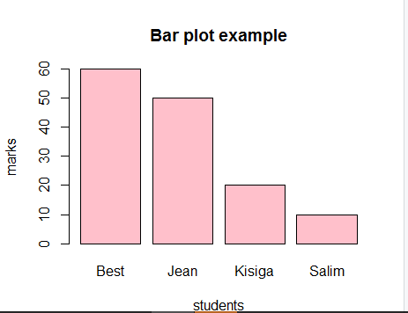
Bar plot example

